Slide 1
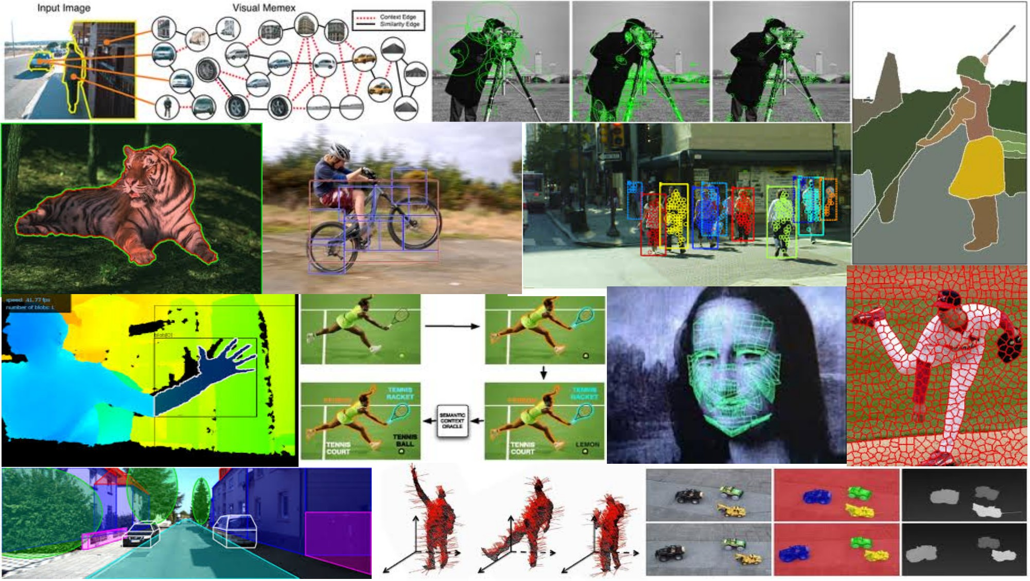
Generic object recognition May 17th, 2018
Yong Jae Lee
UC Davis

Slide 2
Visual words
Map high-dimensional descriptors to tokens/words by quantizing the feature space
Quantize via clustering, let cluster centers be the prototype “words”
Word #2
Determine which word to assign to each new image region by finding the closest cluster center.
Descriptor’s feature space
Kristen Grauman

Slide 3
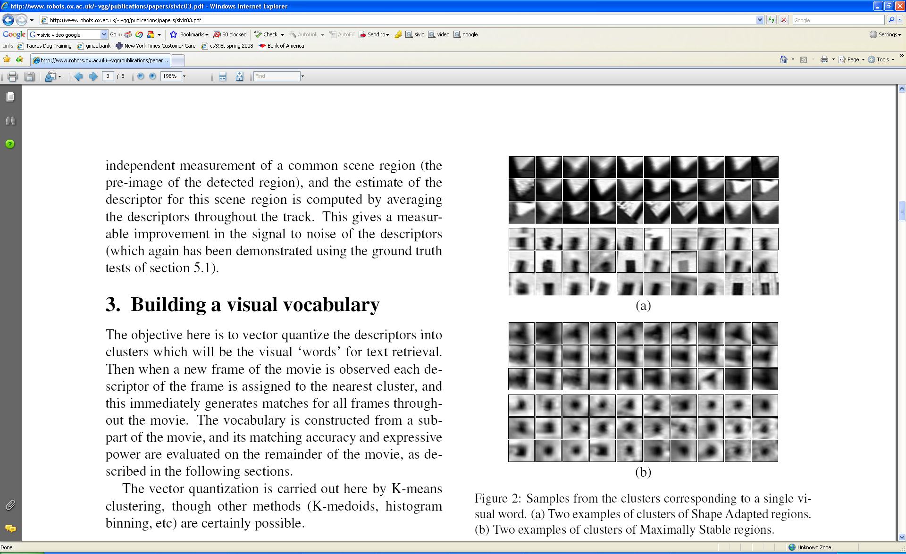
Visual words
Example: each group of patches belongs to the same visual word
Figure from Sivic & Zisserman, ICCV 2003
Kristen Grauman

Slide 4
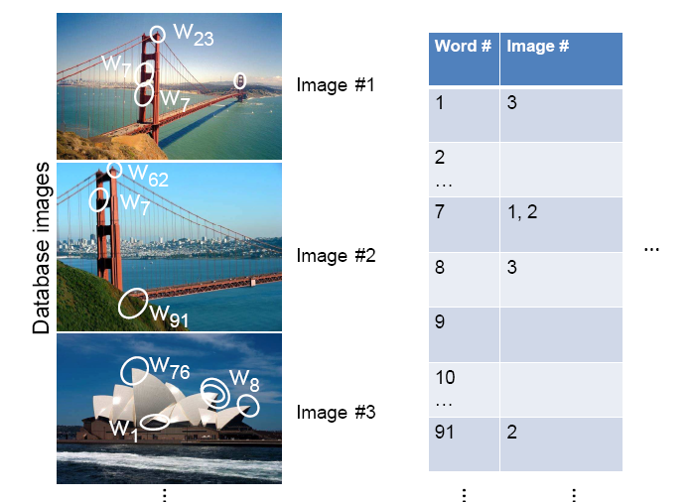
Inverted file index
Database images are loaded into the index mapping words to image numbers
Kristen Grauman

Slide 5
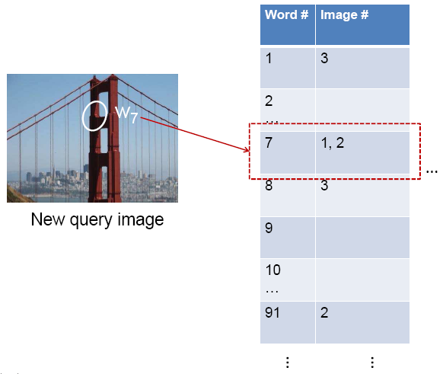
Inverted file index
New query image is mapped to indices of database images that share a word.
Kristen Grauman

Slide 6
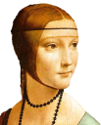
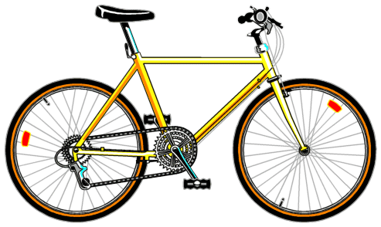
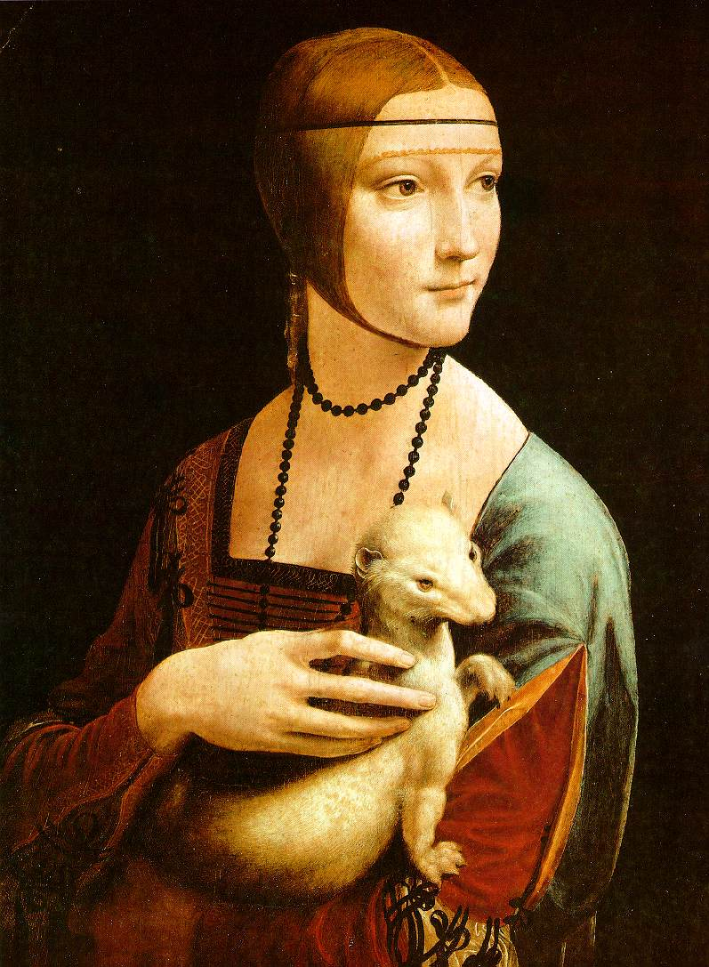
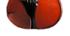
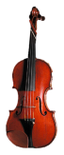
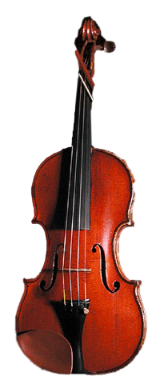
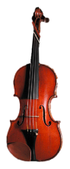

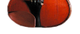

Bags of visual words
Summarize entire image based on its distribution (histogram) of word occurrences.
Analogous to bag of words representation commonly used for documents.
Notes:
6

Slide 7

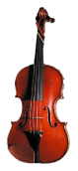



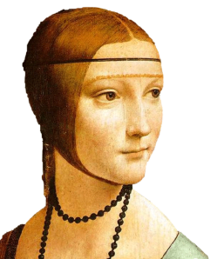
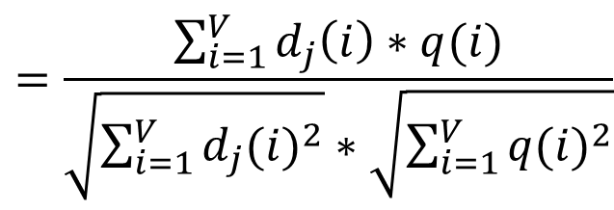
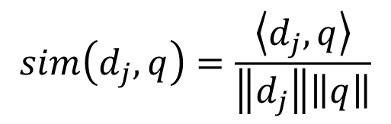
Comparing bags of words
Rank frames by normalized scalar product between their (possibly weighted) occurrence counts---nearest neighbor search for similar images.
[1 8 1 4]
[5 1 1 0]
$$sim\left(d_{j},q\right)=\frac{\left\langle d_{j},q\right\rangle }{\left\|d_{j}\right\|\left\|q\right\|}$$
$$=\frac{\sum_{i=1}^{V}{d_{j}\left(i\right)∗q(i)}}{\sqrt{\sum_{i=1}^{V}{{d_{j}(i)}^{2}}}∗\sqrt{\sum_{i=1}^{V}{{q(i)}^{2}}}}$$
for vocabulary of V words
Kristen Grauman

Slide 8
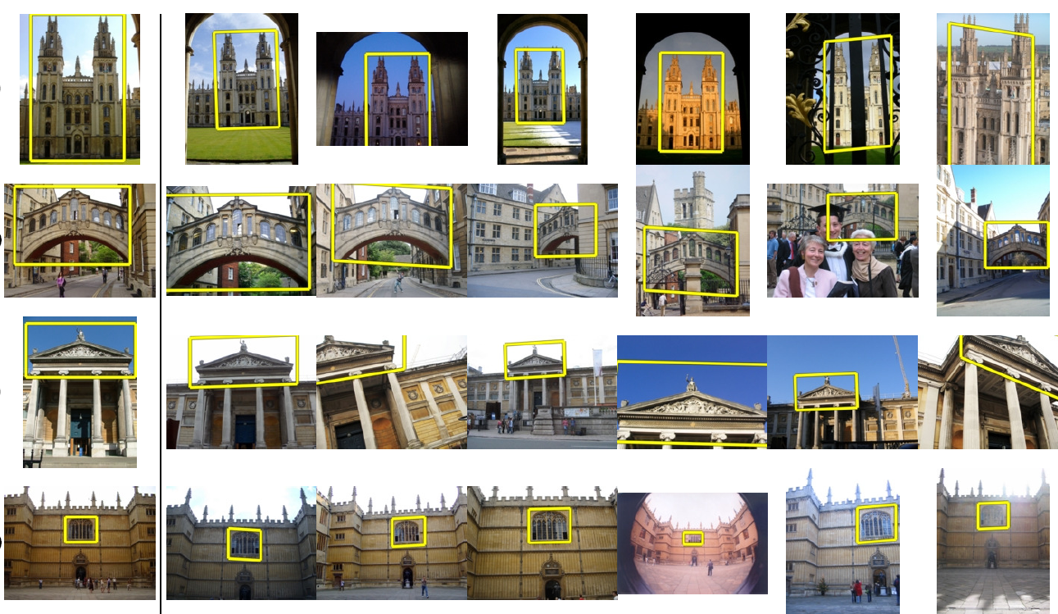
Application: Large-Scale Retrieval
Query
Results from 5k Flickr images (demo available for 100k set)
[Philbin CVPR’07]

Slide 9
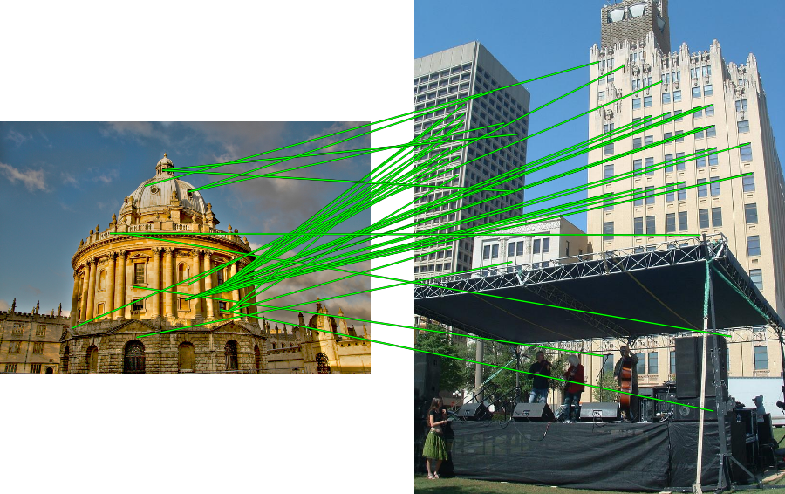
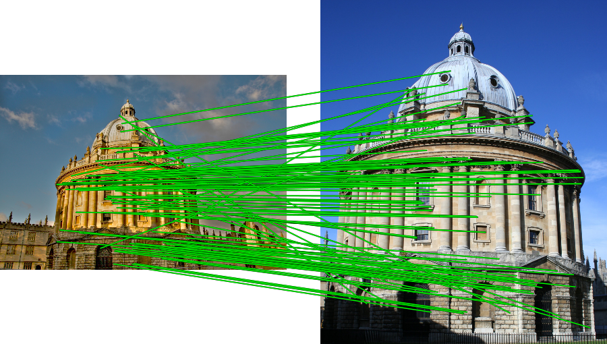
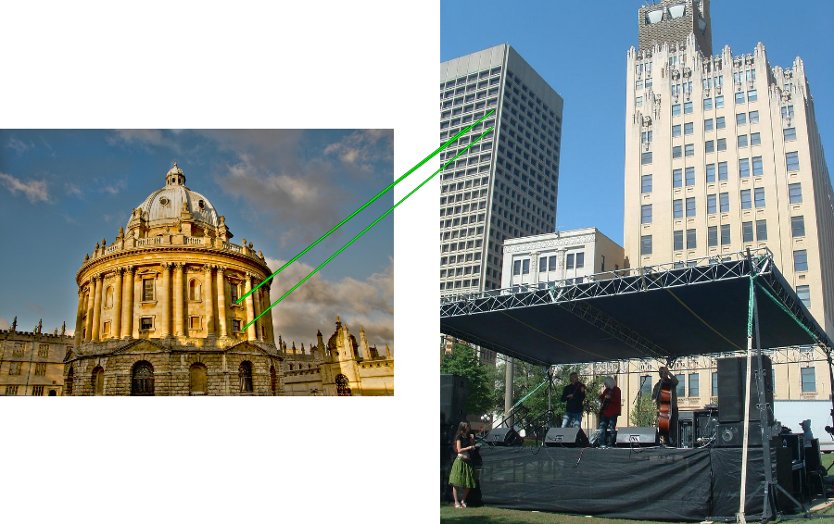
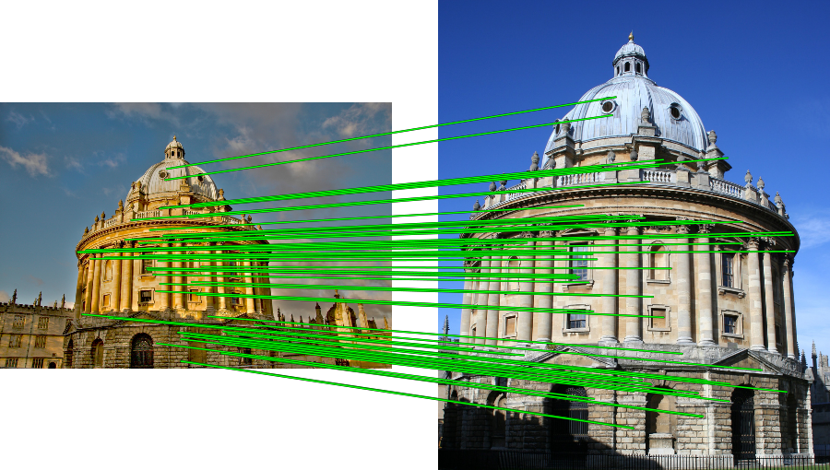
Spatial Verification: RANSAC

Slide 10
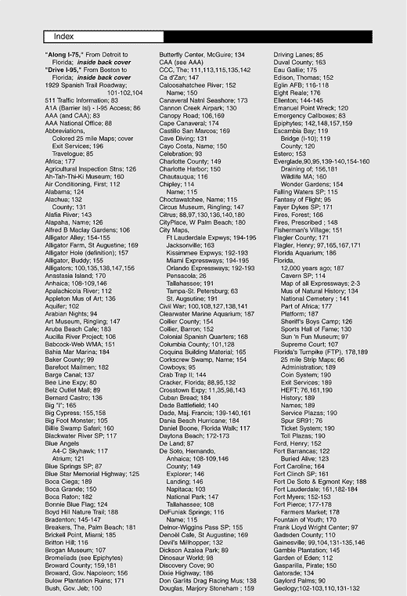

What else can we borrow from text retrieval?
China is forecasting a trade surplus of $90bn (£51bn) to $100bn this year, a threefold increase on 2004's $32bn. The Commerce Ministry said the surplus would be created by a predicted 30% jump in exports to $750bn, compared with a 18% rise in imports to $660bn. The figures are likely to further annoy the US, which has long argued that China's exports are unfairly helped by a deliberately undervalued yuan. Beijing agrees the surplus is too high, but says the yuan is only one factor. Bank of China governor Zhou Xiaochuan said the country also needed to do more to boost domestic demand so more goods stayed within the country. China increased the value of the yuan against the dollar by 2.1% in July and permitted it to trade within a narrow band, but the US wants the yuan to be allowed to trade freely. However, Beijing has made it clear that it will take its time and tread carefully before allowing the yuan to rise further in value.
China, trade,
surplus, commerce,
exports, imports, US,
yuan, bank, domestic,
foreign, increase,
trade, value

Slide 11
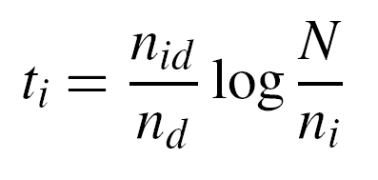
tf-idf weighting
Term frequency – inverse document frequency
Describe frame by frequency of each word within it, downweight words that appear often in the database
(Standard weighting for text retrieval)
Number of occurrences of word i in document d
Total number of documents in database
Number of documents word i occurs in, in whole database
Number of words in document d
Kristen Grauman

Slide 12
Query expansion
Query: golf green
Results:
- How can the grass on the greens at a golf course be so perfect?
For example, a skilled golfer expects to reach the green on a par-four hole in ... - Manufactures and sells synthetic golf putting greens and mats.
Irrelevant result can cause a `topic drift’:
Volkswagen Golf, 1999, Green, 2000cc, petrol, manual, , hatchback, 94000miles, 2.0 GTi, 2 Registered Keepers, HPI Checked, Air-Conditioning, Front and Rear Parking Sensors, ABS, Alarm, Alloy
Slide credit: Ondrej Chum

Slide 13
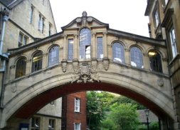
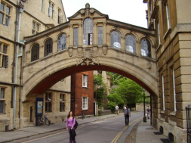
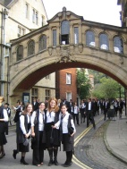
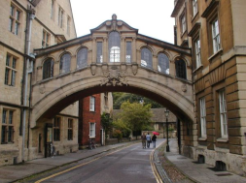
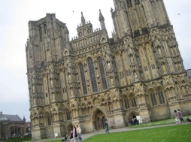
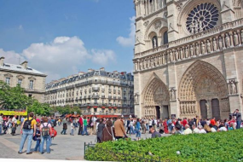
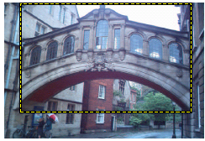
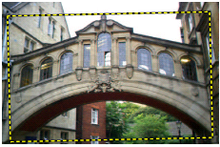
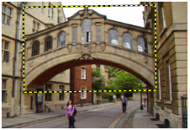
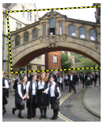
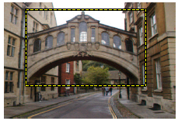
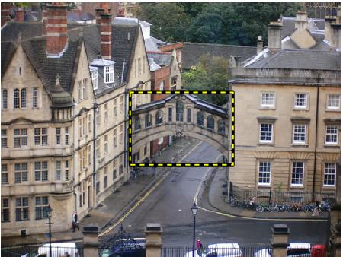
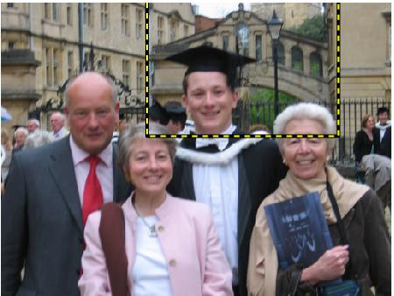
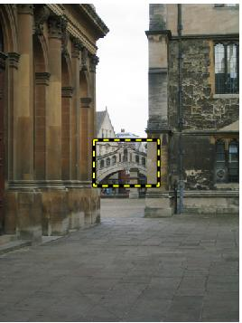
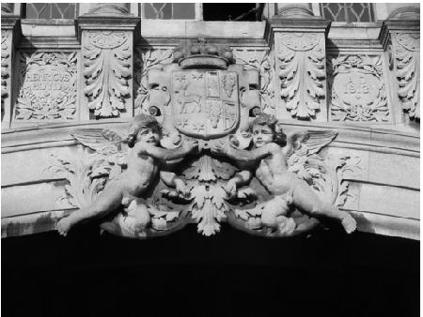
Query expansion
Results
…
Spatial verification
Query image
New results
New query
Chum, Philbin, Sivic, Isard, Zisserman: Total Recall…, ICCV 2007
Slide credit: Ondrej Chum

Slide 14
Recognition via local-feature based alignment
Pros:
Effective when we are able to find reliable features within clutter
Great results for matching specific instances
Cons:
Spatial verification as post-processing – not seamless, expensive for large-scale problems
Not suited for generic category recognition
Kristen Grauman

Slide 15


Making the Sky Searchable: Fast Geometric Hashing for Automated Astrometry
Sam Roweis, Dustin Lang & Keir Mierle
University of Toronto
David Hogg & Michael Blanton
New York University
15

Slide 16
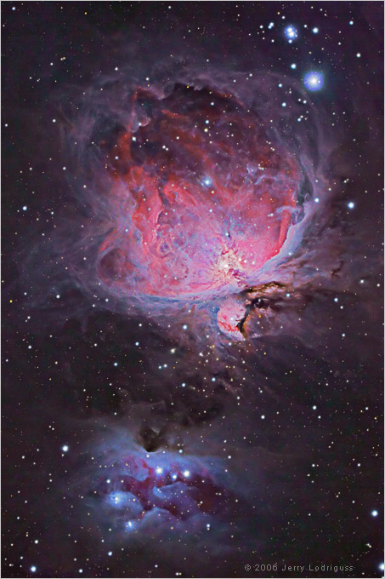
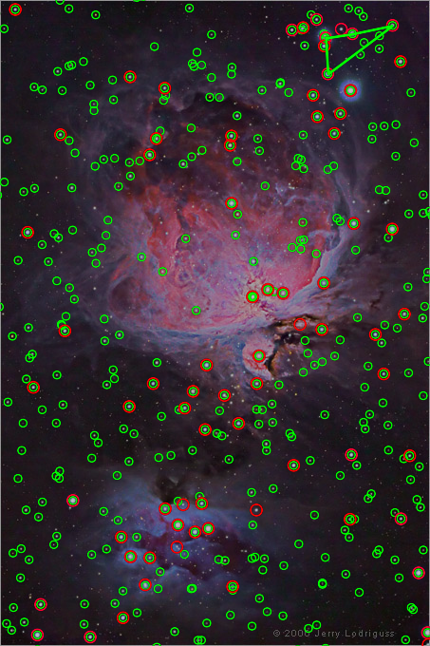
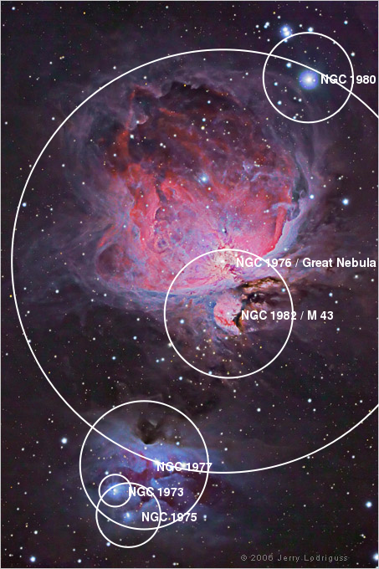
Example
A shot of the Great Nebula, by Jerry Lodriguss (c.2006), from astropix.com
http://astrometry.net/gallery.html
Notes:
http://cosmo.nyu.edu/hogg/research/2006/09/28/astrometry_google.pdf
The red circles are stars the algorithm automatically detects in the image, and the green circles are stars from the master index which appear in the query image.
Nebulae, constellations and other objects can be automatically overlayed on the image after it has been solved.
The features used are the relative positions of nearby quadruples of stars.

Slide 17
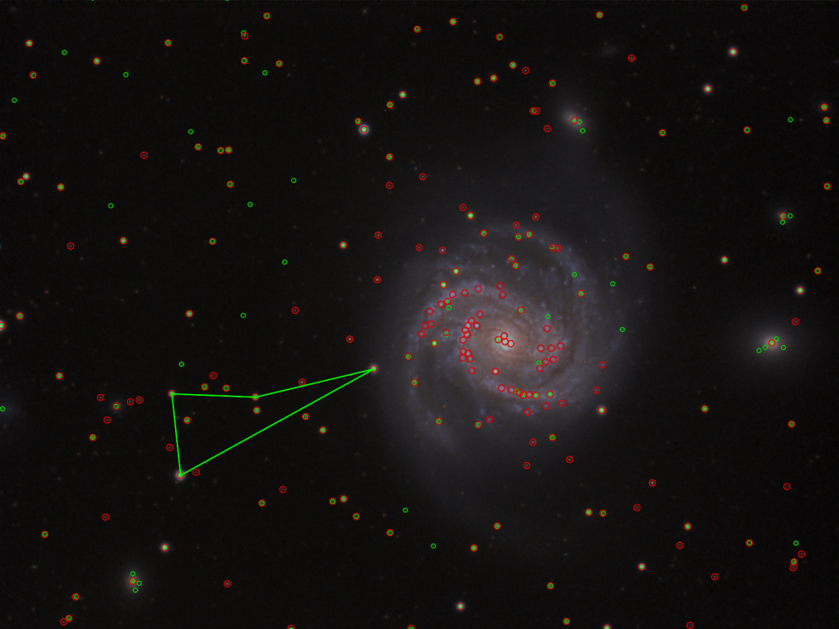
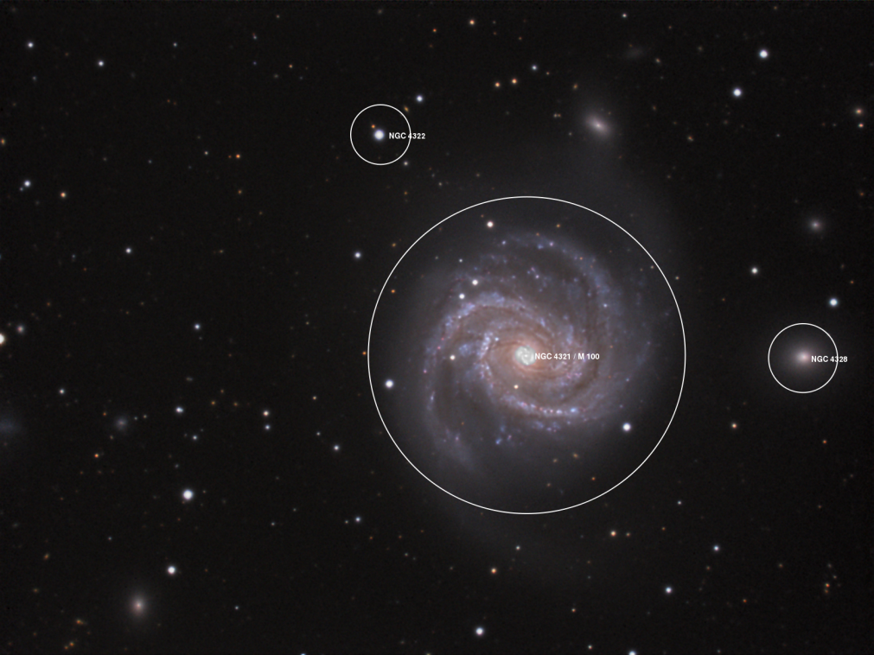
Example
An amateur shot of M100, by Filippo Ciferri (c.2007) from flickr.com http://astrometry.net/gallery.html

Slide 18
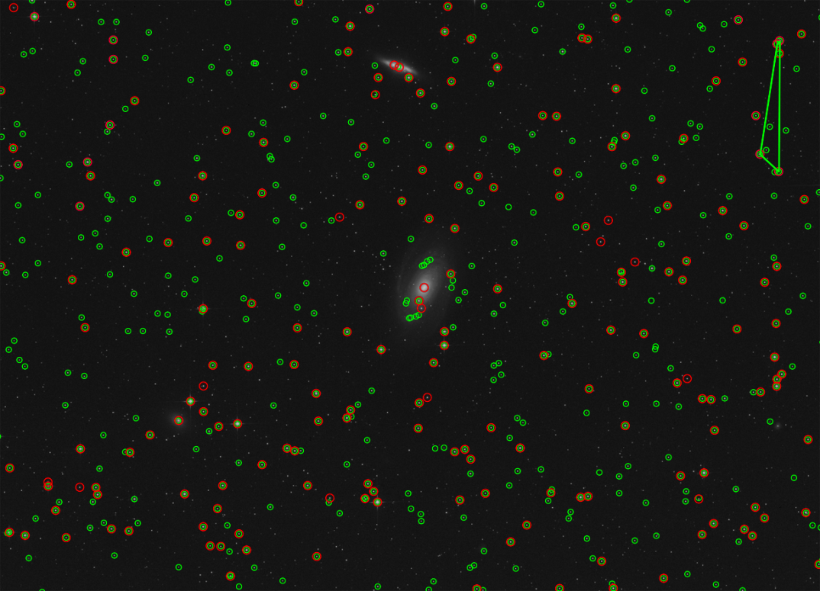
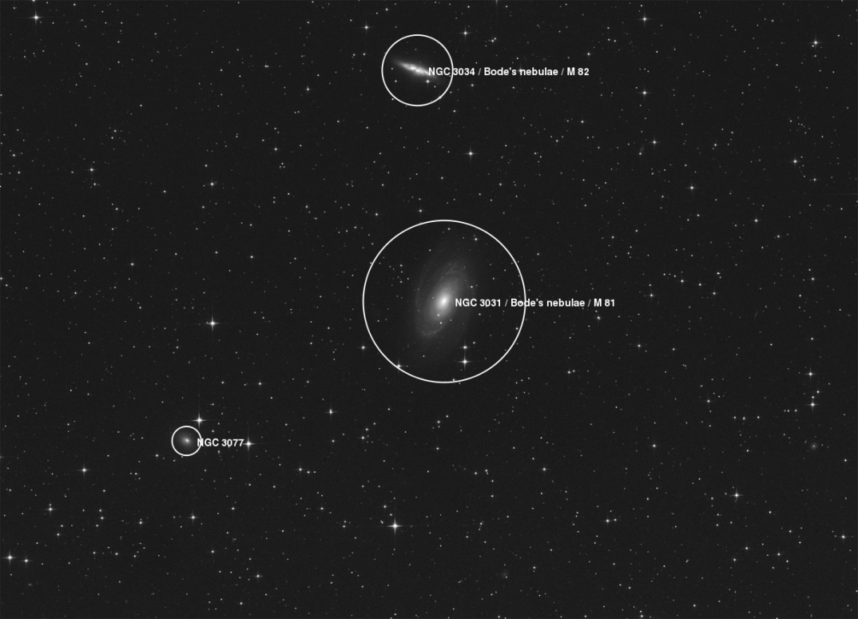
Example
A beautiful image of Bode's nebula (c.2007) by Peter Bresseler, from starlightfriend.de http://astrometry.net/gallery.html

Slide 19
Today
Generic object recognition

Slide 20
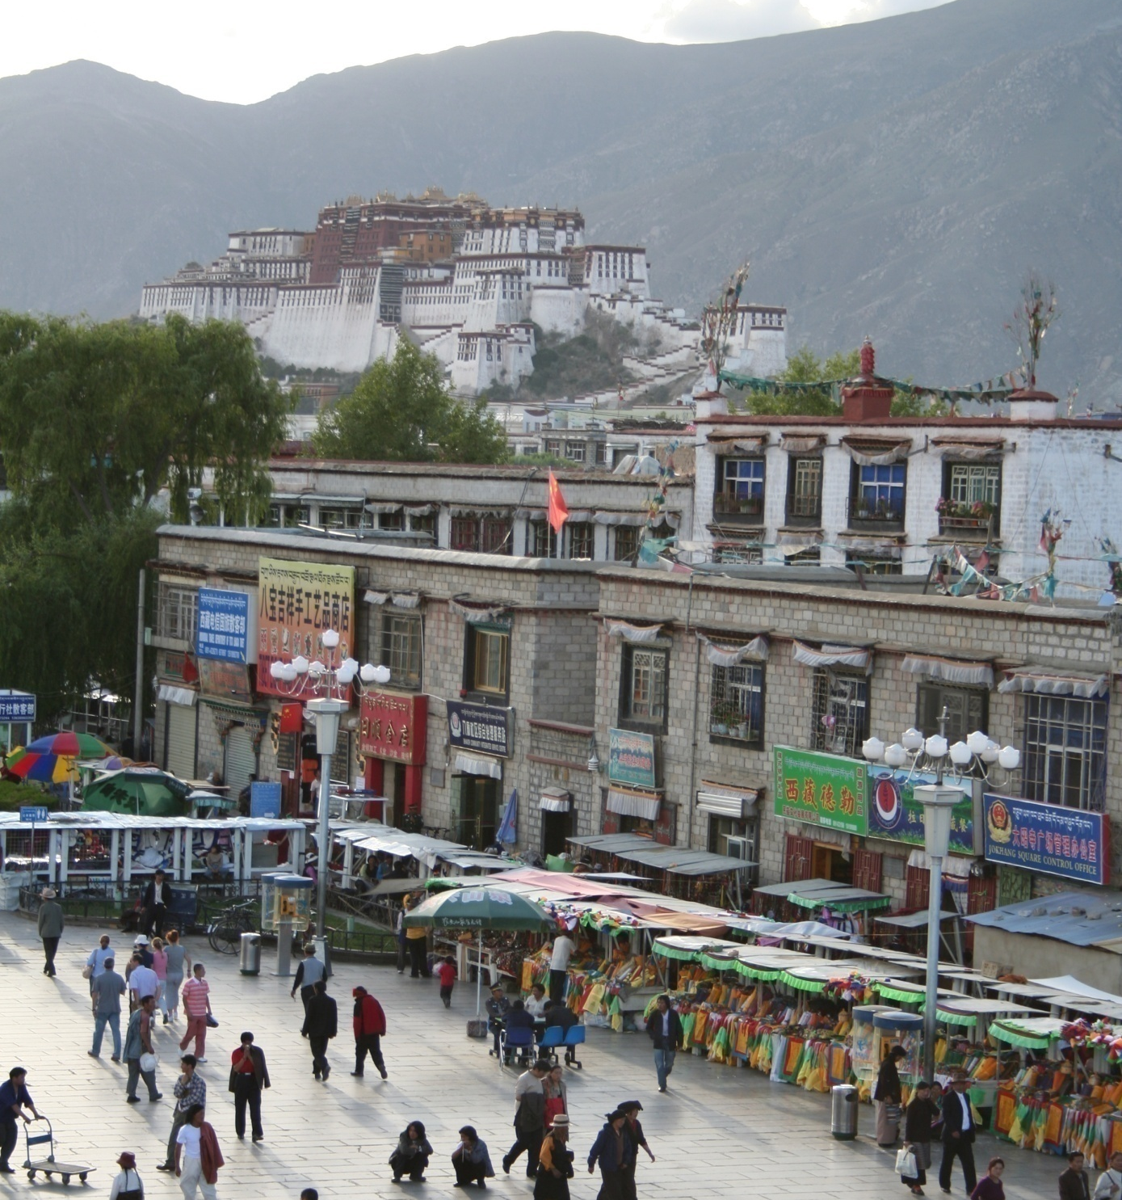
What does recognition involve?
Source: Fei-Fei Li, Rob Fergus, Antonio Torralba.

Slide 21
Verification: is that a lamp?
Source: Fei-Fei Li, Rob Fergus, Antonio Torralba.

Slide 22
Detection: are there people?
Source: Fei-Fei Li, Rob Fergus, Antonio Torralba.

Slide 23
Identification: is that Potala Palace?
Source: Fei-Fei Li, Rob Fergus, Antonio Torralba.

Slide 24
Object categorization
mountain
tree
building
banner
street lamp
vendor
people
Source: Fei-Fei Li, Rob Fergus, Antonio Torralba.

Slide 25
Scene and context categorization
outdoor
city
…
Source: Fei-Fei Li, Rob Fergus, Antonio Torralba.

Slide 26
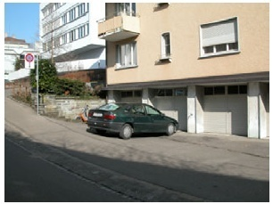
Instance-level recognition problem
John’s car

Slide 27
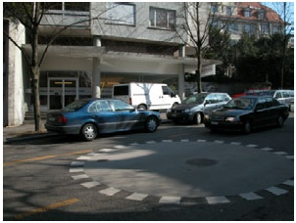
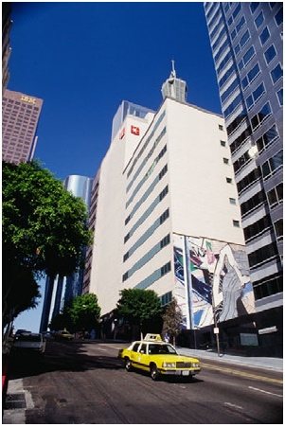
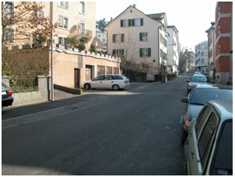

Generic categorization problem

Slide 28

Object Categorization
“Fido”
German shepherd
dog
animal
living being
K. Grauman, B. Leibe
Task Description
“Given a small number of training images of a category, recognize a-priori unknown instances of that category and assign the correct category label.”
Which categories are feasible visually?

Slide 29
Visual Object Categories
Basic Level Categories in human categorization [Rosch 76, Lakoff 87]
The highest level at which category members have similar perceived shape
The highest level at which a single mental image reflects the entire category
The level at which human subjects are usually fastest at identifying category members
The first level named and understood by children
The highest level at which a person uses similar motor actions for interaction with category members
K. Grauman, B. Leibe

Slide 30
Visual Object Categories
…
animal
Abstract levels
…
…
quadruped
…
Basic level
dog
cat
cow
German shepherd
Doberman
Individual level
…
“Fido”
…
K. Grauman, B. Leibe
Basic-level categories in humans seem to be defined predominantly visually.
There is evidence that humans (usually) start with basic-level categorization before doing identification.

Slide 31


How many object categories are there?
~10,000 to 30,000
Biederman 1987
Source: Fei-Fei Li, Rob Fergus, Antonio Torralba.
Notes:
31

Slide 32

~10,000 to 30,000
Notes:
32

Slide 33







Other Types of Categories
K. Grauman, B. Leibe
Functional Categories
e.g. chairs = “something you can sit on”

Slide 34






Other Types of Categories
K. Grauman, B. Leibe
Ad-hoc categories
e.g. “something you can find in an office environment”

Slide 35
Why recognition?
Recognition a fundamental part of perception
e.g., robots, autonomous agents
Organize and give access to visual content
Connect to information
Detect trends and themes
Notes:
35

Slide 36





Posing visual queries
Yeh et al., MIT
Belhumeur et al.
Kooaba, Bay & Quack et al.

Slide 37


Autonomous agents able to detect objects

Slide 38

Finding visually similar objects
Notes:
38

Slide 39



Discovering visual patterns
Objects
Sivic & Zisserman
Lee & Grauman
Categories
Actions
Wang et al.
Kristen Grauman

Slide 40


Auto-annotation
Gammeter et al.
T. Berg et al.
Kristen Grauman

Slide 41







Challenges: robustness
Illumination
Object pose
Clutter
Occlusions
Intra-class appearance
Viewpoint
Kristen Grauman

Slide 42
Challenges: robustness
Realistic scenes are crowded, cluttered, have overlapping objects.

Slide 43


Challenges: importance of context
slide credit: Fei-Fei, Fergus & Torralba

Slide 44

Challenges: importance of context

Slide 45






Challenges: complexity
10 billion images
250 billion images
1 billion images served daily
10 billion images
100 hours uploaded per minute
Almost 90% of web traffic is visual!

Slide 46
Challenges: complexity
Thousands to millions of pixels in an image
30+ degrees of freedom in the pose of articulated objects (humans)
About half of the cerebral cortex in primates is devoted to processing visual information [Felleman and van Essen 1991]
Kristen Grauman

Slide 47




























Challenges: learning with minimal supervision
Less
More
Unlabeled, multiple objects
Classes labeled, some clutter
Cropped to object, parts and classes labeled
Kristen Grauman

Slide 48

What works today
Reading license plates, zip codes, checks
Source: Lana Lazebnik
Notes:
48

Slide 49

What works today
Source: Lana Lazebnik
Reading license plates, zip codes, checks
Fingerprint recognition
Notes:
49

Slide 50


What works today
Source: Lana Lazebnik
Reading license plates, zip codes, checks
Fingerprint recognition
Face detection
Notes:
50

Slide 51
What works today
Reading license plates, zip codes, checks
Fingerprint recognition
Face detection
Recognition of flat textured objects (CD covers, book covers, etc.)
Source: Lana Lazebnik
Notes:
51

Slide 52



What works today
Reading license plates, zip codes, checks
Fingerprint recognition
Face detection
Recognition of flat textured objects (CD covers, book covers, etc.)
Recognition of generic categories(*)!
Notes:
52

Slide 53


Progress charted by datasets
Roberts 1963
COIL
1963
…
1996
Slide credit: Kristen Grauman

Slide 54





Progress charted by datasets
MIT-CMU Faces
INRIA Pedestrians
UIUC Cars
1963
…
1996
2000
Slide credit: Kristen Grauman

Slide 55


Progress charted by datasets
MSRC 21 Objects
Caltech-101
Caltech-256
1963
…
1996
2000
2005
Slide credit: Kristen Grauman

Slide 56







Progress charted by datasets
ImageNet
80M Tiny Images
PASCAL VOC
Birds-200
Faces in the Wild
…
1996
2000
2005
2007
2013
1963
2008
Slide credit: Kristen Grauman

Slide 57
Evolution of methods
Hand-crafted models
3D geometry
Hypothesize and align
Hand-crafted features
Learned models
Data-driven
“End-to-end” learning of features and models*,**
* Labeled data availability
** Architecture design decisions, parameters.
Kristen Grauman

Slide 58

Supervised classification
Given a collection of labeled examples, come up with a function that will predict the labels of new examples.
How good is the function we come up with to do the classification?
Depends on
Mistakes made
Cost associated with the mistakes
“four”
“nine”
?
Training examples
Novel input
Kristen Grauman

Slide 59
Supervised classification
Given a collection of labeled examples, come up with a function that will predict the labels of new examples.
Consider the two-class (binary) decision problem
L(4→9): Loss of classifying a 4 as a 9
L(9→4): Loss of classifying a 9 as a 4
Risk of a classifier s is expected loss:
We want to choose a classifier so as to minimize this total risk
Kristen Grauman
Notes:
p(4 → 9|using x): probability that class 4 is labeled as class 9
L(4 → 9): loss incurred when an object of type 4 is classified as having type 9

Slide 60
Supervised classification
Optimal classifier will minimize total risk.
At decision boundary, either choice of label yields same expected loss.
Feature value x
If we choose class “four” for point x at boundary, expected loss is:
If we choose class “nine” for point x at boundary, expected loss is:
Kristen Grauman
Notes:
If the decision boundary is optimal, then for points on the decision boundary, either choice of class has the same expected loss; if this weren’t so, we could obtain a better classifier by always choosing one class (and so moving the boundary)
http://luthuli.cs.uiuc.edu/~daf/courses/probcourse/notesclassification.pdf

Slide 61
Supervised classification
Optimal classifier will minimize total risk.
At decision boundary, either choice of label yields same expected loss.
Feature value x
So, best decision boundary is at point x where
To classify a new point, choose class with lowest expected loss; i.e., choose “four” if
Kristen Grauman
Notes:
expected loss of classifying as 4 is less than expected loss of classifying as 9

Slide 62
Supervised classification
Optimal classifier will minimize total risk.
At decision boundary, either choice of label yields same expected loss.
P(4 | x)
P(9 | x)
Feature value x
So, best decision boundary is at point x where
To classify a new point, choose class with lowest expected loss; i.e., choose “four” if
How to evaluate these probabilities?
Kristen Grauman

Slide 63





Probability
Basic probability
X is a random variable
P(X) is the probability that X achieves a certain value
or
Conditional probability: P(X | Y)
probability of X given that we already know Y
called a PDF
probability distribution/density function
continuous X
discrete X
Source: Steve Seitz

Slide 64

Example: learning skin colors
We can represent a class-conditional density using a histogram (a “non-parametric” distribution)
Percentage of skin pixels in each bin
P(x|skin)
Feature x = Hue
P(x|not skin)
Feature x = Hue
Kristen Grauman

Slide 65

Example: learning skin colors
We can represent a class-conditional density using a histogram (a “non-parametric” distribution)
P(x|skin)
Feature x = Hue
Now we get a new image, and want to label each pixel as skin or non-skin.
What’s the probability we care about to do skin detection?
P(x|not skin)
Feature x = Hue
Kristen Grauman
Notes:
P(skin | x) -> probability of skin given pixel color x.

Slide 66
Bayes rule
posterior
likelihood
prior
Where does the prior come from?
Why use a prior?
Notes:
Prior: how often there are skin pixels vs non-skin pixels.

Slide 67


Example: classifying skin pixels
Now for every pixel in a new image, we can estimate probability that it is generated by skin.
Brighter pixels → higher probability of being skin
Classify pixels based on these probabilities

Slide 68

Example: classifying skin pixels
Gary Bradski, 1998

Slide 69


Example: classifying skin pixels
Using skin color-based face detection and pose estimation as a video-based interface
Gary Bradski, 1998

Slide 70
Supervised classification
Want to minimize the expected misclassification
Two general strategies
Use the training data to build representative probability model; separately model class-conditional densities and priors (generative)
Directly construct a good decision boundary, model the posterior (discriminative)

Slide 71
Coming up
Face detection
Categorization with local features and part-based models
Deep convolutional neural networks

Slide 72
Questions?
See you Tuesday!

